Slide 1
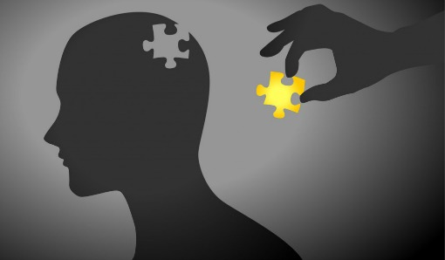
Social Influence Theory
AEPSY Year 11 ATAR Psychology

Slide 2
Review
Give an example of intergroup cooperation as a means for reducing prejudice.
Explain the difference between situational and dispositional attribution, using an example.
List three attachment types, according to Ainsworth’s Strange Situation Experiment.
Describe or name one test that would demonstrate competency in the Concrete Operational Stage.

Slide 3
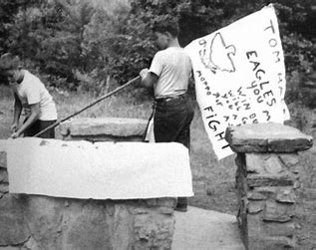
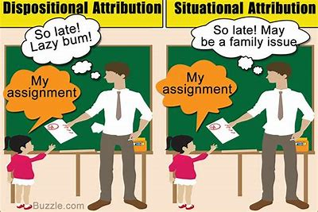
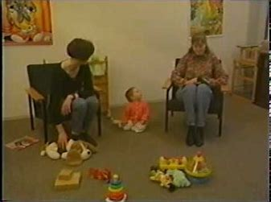
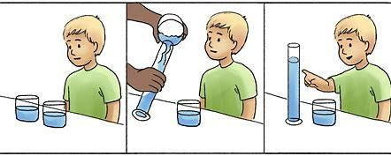

Slide 4
Learning Intentions
Social Influence Theory (Kelman, 1958)
Compliance
Identification
Internalisation
Obedience
social response to authority

Slide 5
Success Criteria
List 3 levels of social influence
For each, describe the process of influence
For each, identify the influencing agent
For each, give two examples
Distinguish between obedience and conformity

Slide 6
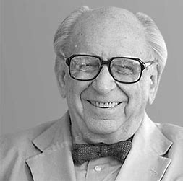
Herbert Kelman (1927-2022)
Austrian born American psychologist recognised for his work on conflict resolution in the Middle East.

Slide 7
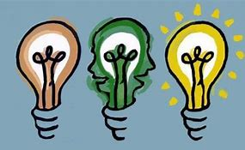
Social Influence Theory, 1958
Social Influence: real or implied presence of people influences attitudes, beliefs and/or behaviours of others.
eg, obedience and conformity
What is the difference between
obedience and conformity?

Slide 8
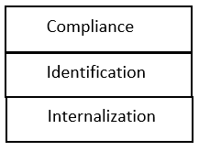
Levels of influence
There are three processes of influence, each depending on the level at which people accept that they are influenced.
These can be explained in terms of the reasoning people give for being influenced and the influencing agent or ‘power source’.

Slide 9
Compliance
Changing behaviour with the aim of receiving reward or avoidance of punishment, without changing beliefs.
Influencing agents are those in authority, who have power to reward or punish, and influence is accepted conditionally or even begrudgingly.

Slide 10


Slide 11

Identification
Changing attitudes and behaviour with the aim of establishing or sustaining a satisfying relationship.
Influencing agents are those with whom being in a relationship has benefit or someone they like and respect, like a role model.
Influence is accepted because it is associated with desirable relationship but is conditional on continued benefit from that relationship.

Slide 12


Slide 13
Internalisation
Influence is readily accepted because attitudes, values and beliefs are aligned with their own and are intrinsically satisfying.
Influencing agents are those with credibility, trustworthiness and recognised expertise.

Slide 14
Strengths of Kelman’s Theory
Compliance, identification and internalisation can be tested experimentally (either by observation or experimentation)
Kelman’s theory has been applied clinically, with measurable influence on patient behaviour both in therapy and in real-life situations.

Slide 15
Limitations of Kelman’s Theory
Only behaviour can be observed and analysed, and this is difficult to observe without influencing.
Kelman’s model does not apply to all social interactions or changes in attitude (applications most suited to educational institutions such as schools and universities).

Slide 16
Success Criteria
List 3 levels of social influence
For each, describe the process of influence
For each, identify the influencing agent
For each, give two examples
Distinguish between obedience and conformity

